Slide 1


Day 2: Practical Prometheus & Grafana
Notes:
Introduction & Objectives:
Firstly, we would like to thank you for choosing CMC as Managed Service provider. Thank you for taking the time to attend Kickoff meeting today.
This kickoff meeting shall lay the foundation for a successful Managed Service project, ensure HSG and CMC teams are on the same page with the scope, objectives, timeline, communication and everything in between.
At CMC side, we have Mr. Lam is Service Delivery Manager, v.v.. Sales, technical guys
Could you introduce HSG’s members

Slide 2
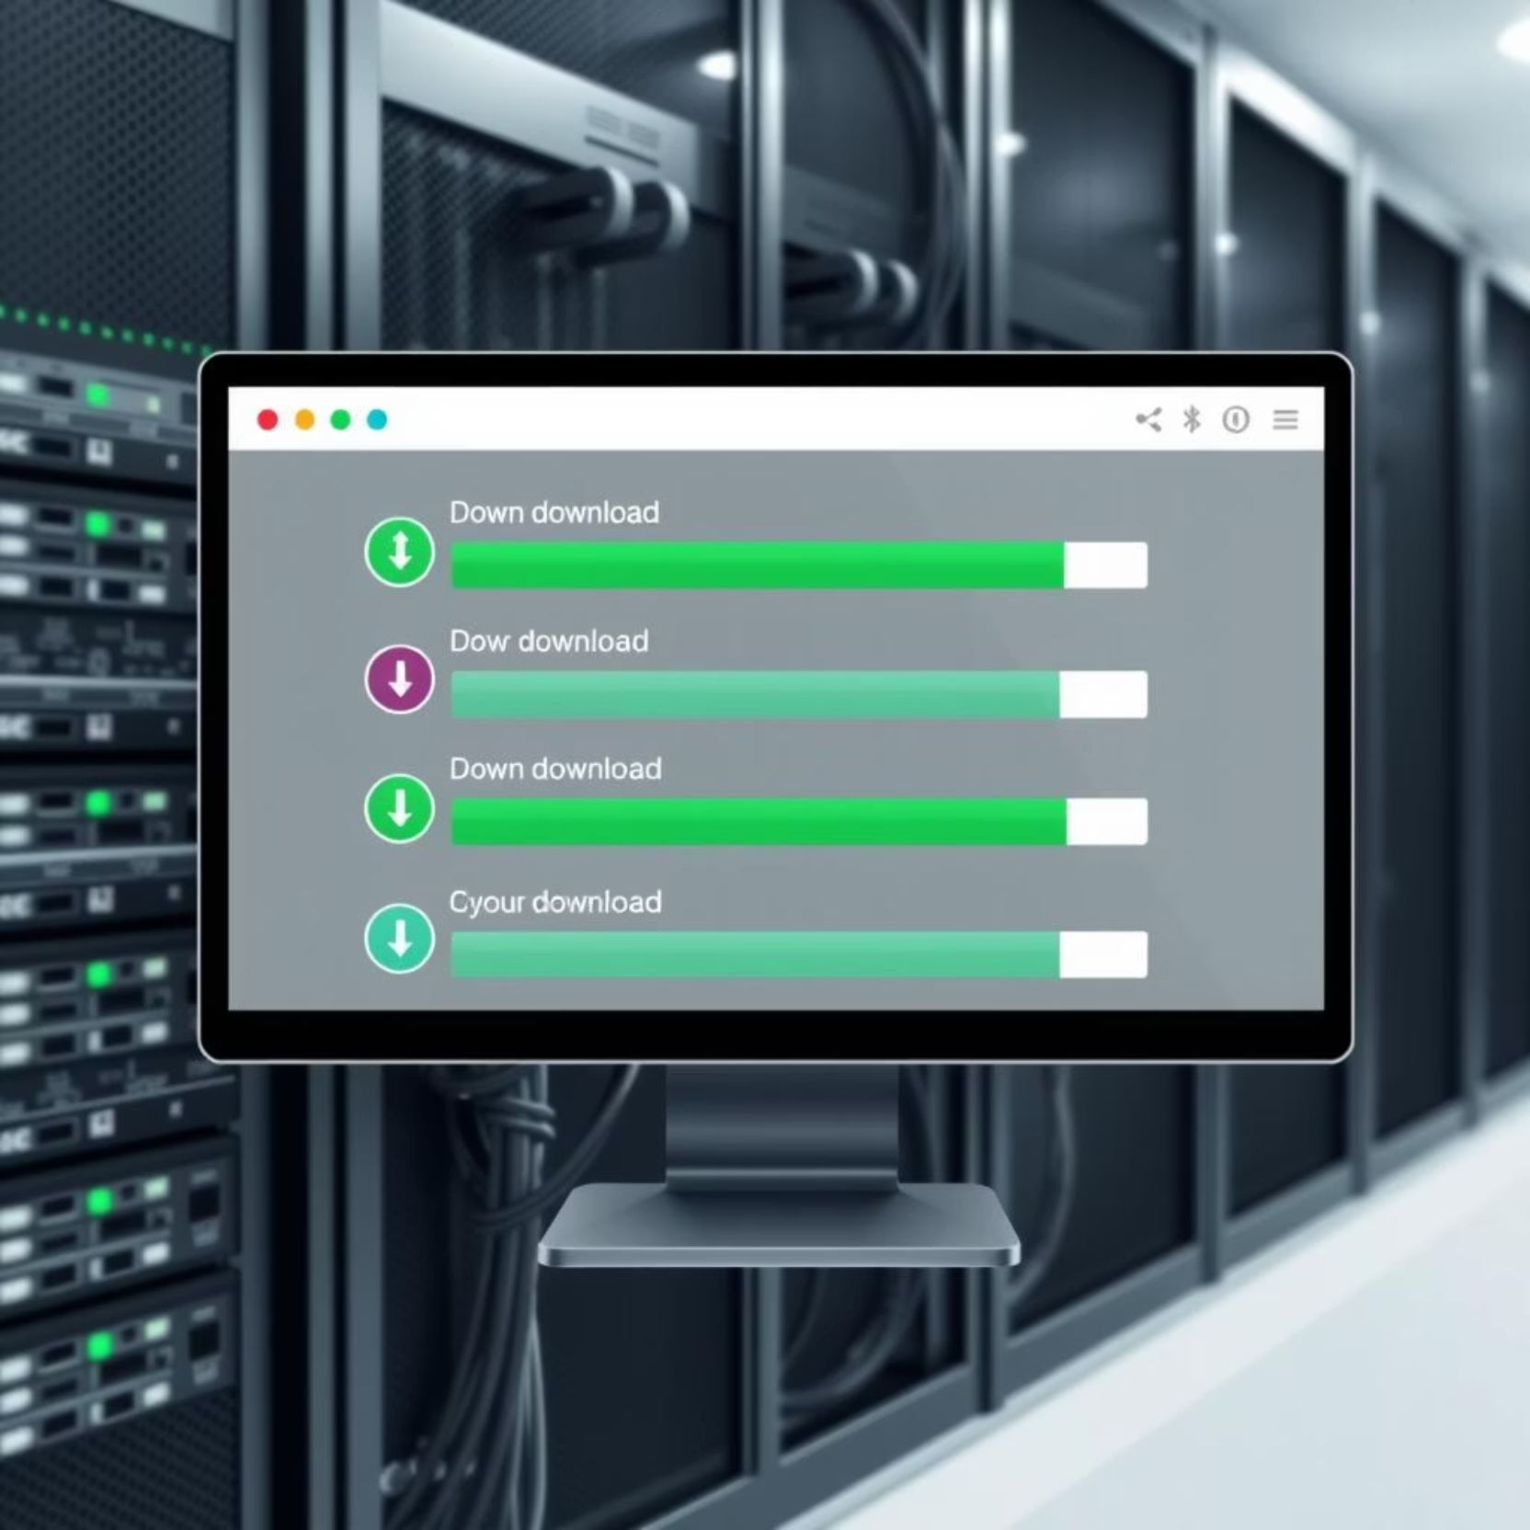
Setting Up Prometheus and Grafana
To get started, download Prometheus and Node Exporter from their official sites. Install Grafana either locally or leverage Grafana Cloud for ease of use.
Prometheus runs on default port 9090.
Grafana runs on default port 3000.
Verify Node Exporter metrics are accessible at http://localhost:9100/metrics.

Slide 3
Adding Targets to Prometheus (prometheus.yml)
Configuration File
Example: Static Configs
Running Prometheus
The prometheus.yml file is central to Prometheus, defining which targets it will scrape for metrics. This file specifies the endpoints Prometheus will monitor.
Start Prometheus with your configuration using: ./prometheus --config.file=./prometheus.yml. Confirm target status at http://localhost:9090/targets.
- job_name: 'node' static_configs: - targets: ['localhost:9100']
This example sets up Prometheus to scrape metrics from the Node Exporter running on localhost.

Slide 4
Connecting Prometheus with Grafana
Save and Test
Create Data Source
Ensure to save and test the connection. A successful test indicates Grafana can communicate with your Prometheus instance.
In Grafana, navigate to Data Sources and add a new Prometheus data source. Set the URL to http://localhost:9090.
Customize and Monitor
Import Dashboard
Explore and customize the dashboard to visualize your system metrics effectively, gaining deeper insights into performance.
Import the Node Exporter Server Metrics dashboard using ID 405. This pre-built dashboard provides comprehensive system insights.

Slide 5
Writing Basic PromQL Queries
PromQL is Prometheus's powerful query language for time-series data. It allows for flexible data retrieval and analysis.
CPU Usage: rate(node_cpu_seconds_total[5m])
Memory Usage: node_memory_Active_bytes
Disk Usage: node_filesystem_avail_bytes
Practice in Grafana to create custom charts, filtering and aggregating data for specific insights.

Slide 6
Thank you

